Slide 1

Bengaluru– 560 038, Karnataka, INDIA
Presentation on
MALIGNANT COMMENTS CLASSIFIER
Submitted by:
ADITI GUPTA
Internal Guide
KHUSBOO GARG
SME
Flip Robo Technologies
PGP Instructor
Dr. Deepika Sharma
Training Head
DataTrained

Slide 2
Contents
Introduction
Problem statement
Objectives of the study
Hardware and Software Used
Data Vizualization
Data Preprocessing
EDA
Building Word Dictionary
Model Training
Hyperparameter tuning
Best Model with cross validation
Conclusions
Learning Outcomes in Data Science
Scope for future work

Slide 3
Introduction
The proliferation of social media enables people to express their opinions widely online. However, at the same time, this has resulted in the emergence of conflict and hate, making online environments uninviting for users. Although researchers have found that hate is a problem across multiple platforms, there is a lack of models for online hate detection.
Online hate, described as abusive language, aggression, cyberbullying, hatefulness and many others has been identified as a major threat on online social media platforms. Social media platforms are the most prominent grounds for such toxic behaviour.

Slide 4
Problem Statement
There has been a remarkable increase in the cases of cyberbullying and trolls on various social media platforms. Many celebrities and influences are facing backlashes from people and have to come across hateful and offensive comments. This can take a toll on anyone and affect them mentally leading to depression, mental illness, self-hatred and suicidal thoughts.
Internet comments are bastions of hatred and vitriol. While online anonymity has provided a new outlet for aggression and hate speech, machine learning can be used to fight it. The problem we sought to solve was the tagging of internet comments that are aggressive towards other users. This means that insults to third parties such as celebrities will be tagged as inoffensive, but “u are an idiot” is clearly offensive.
By seeing the dataset it is clear that this is a MULTILABEL CLASSIFICATION.

Slide 5
Objective
The objective of identification of comments are :
To give knowledge to the user about the bad comments and positive comments
To classify that comments are malignant or not.

Slide 6
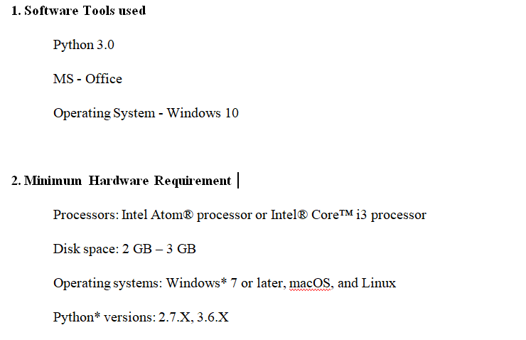
Hardware and Software Requirements and Tools Used

Slide 7
DATA VIZUALIZATION

Slide 8
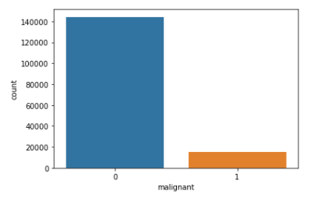
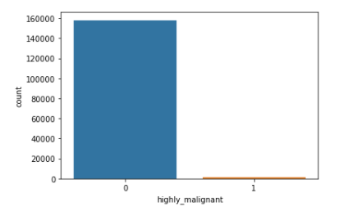
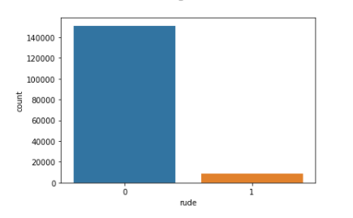
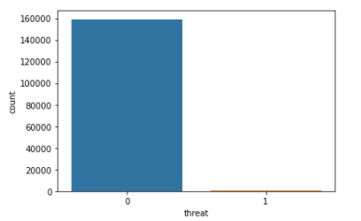
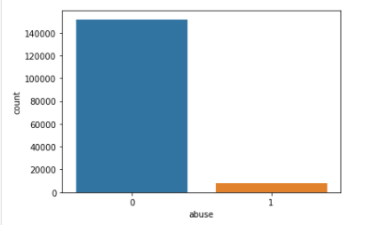

Checking Output Columns
While maximum Categories belong to Malignant, a lot of comments are abusive and rude as well; while threat comments are the minimum

Slide 9
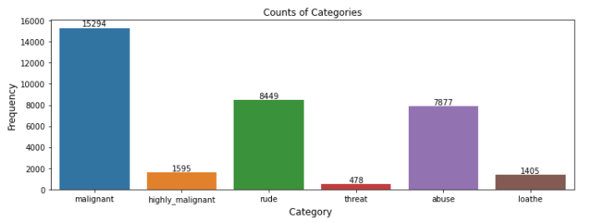
Count Plot for each category

Slide 10
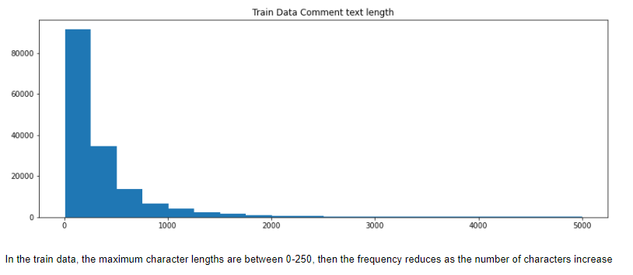
Count Plot for Train Data

Slide 11
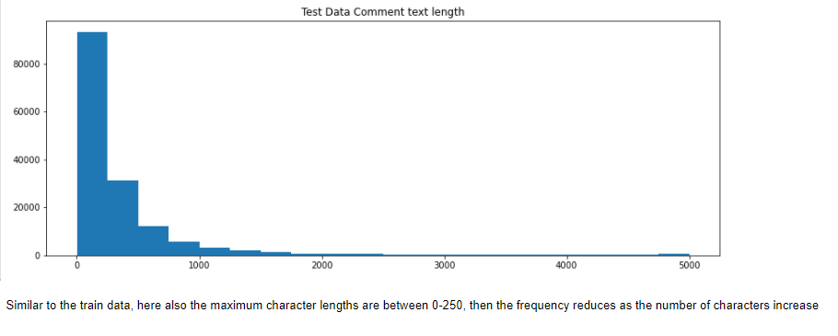
Count Plot for Test Data

Slide 12
DATA PREPROCESSING

Slide 13
DATA PREPROCESSING STEPS
Convert all letters to lower/upper case
Removing numbers
Removing punctuation
Removing white spaces
Removing hyperlink
Removing stop words
Removing Short words (length<=3)
Word lemmatization
Adding 3 new columns (comment_length,clean_comment_text,clean_comment_text_length)
Vectorisation (Using Tf/idf)

Slide 14
EXPLODATORY DATA ANALYSIS

Slide 15
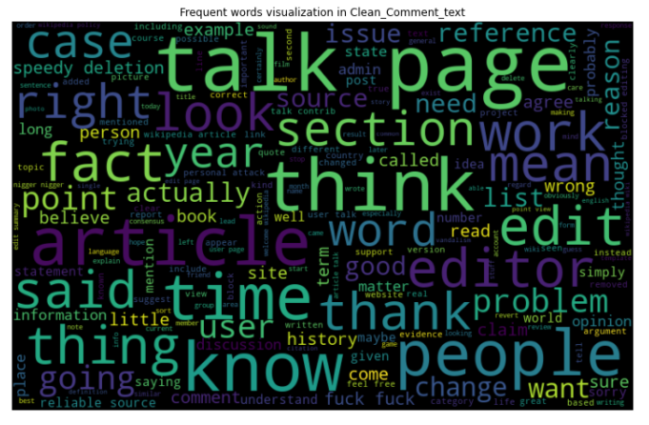
Frequent words in clean comment text

Slide 16
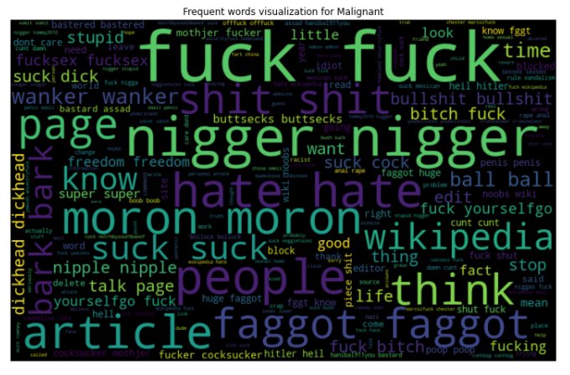
Frequent words which are Malignant

Slide 17
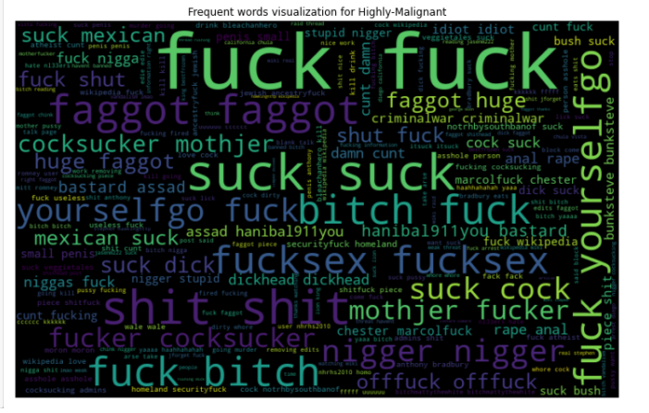
Frequent words which are Highly Malignant

Slide 18
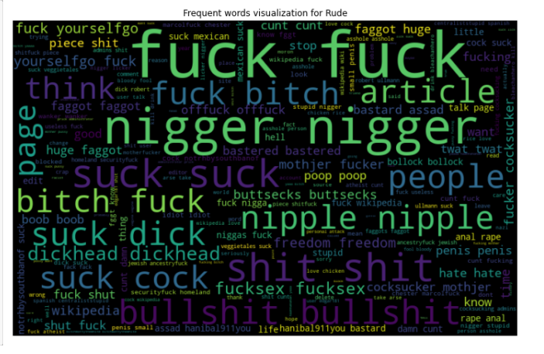
Frequent words which are Rude

Slide 19
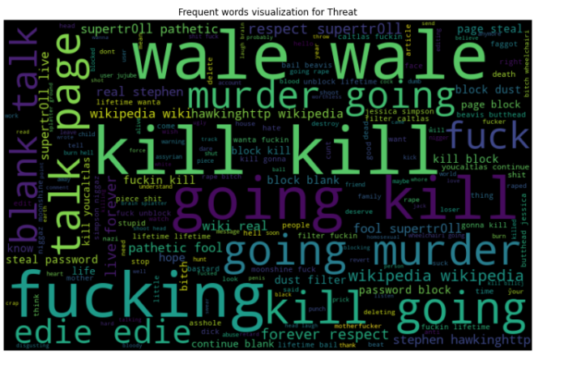
Frequent words which are Threat

Slide 20
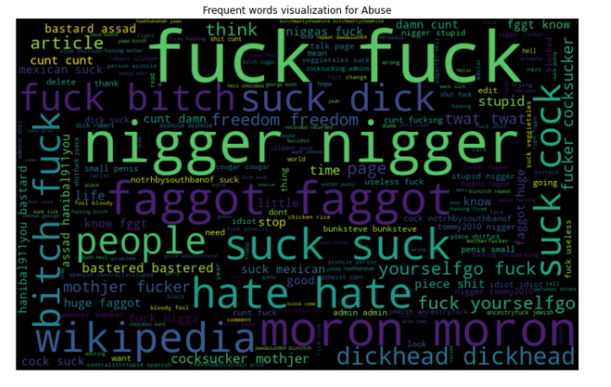
Frequent words which are Abuse

Slide 21
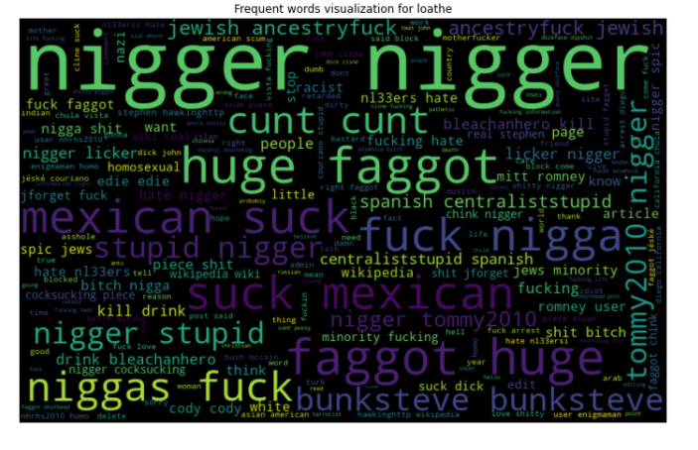
Frequent words which are Loathe

Slide 22
BUILDING WORD DICTIONARY

Slide 23
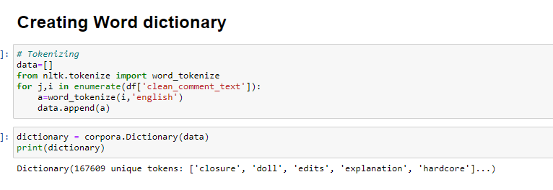

Slide 24
MODEL TRAINING

Slide 25
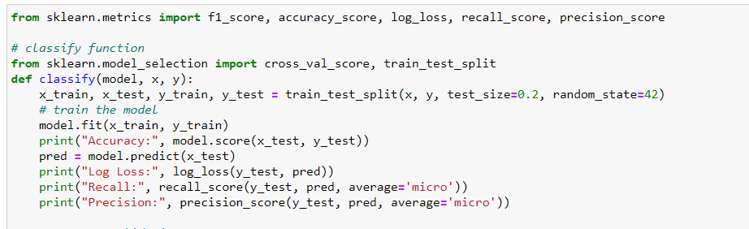
Model/s Development and Evaluation
From the given dataset it can be concluded that it is a Classification problem as the output column “label” has binary output “0 & 1”. So for further analysis of the problem we have to import or call out the Classification related libraries in Python work frame.

Slide 26
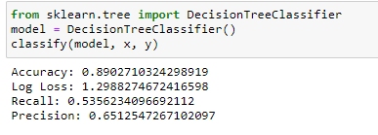
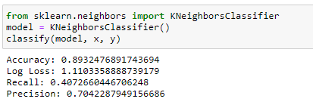
Decision Tree Classifier
Kneighbors Classifier

Slide 27
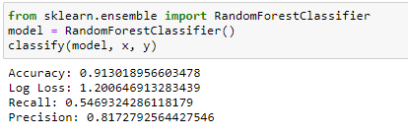
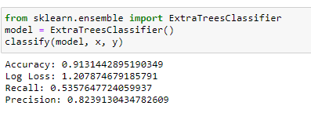
Random Forest Classifier
Extra Trees Classifier

Slide 28
HYPERPARAMETER
TUNING

Slide 29
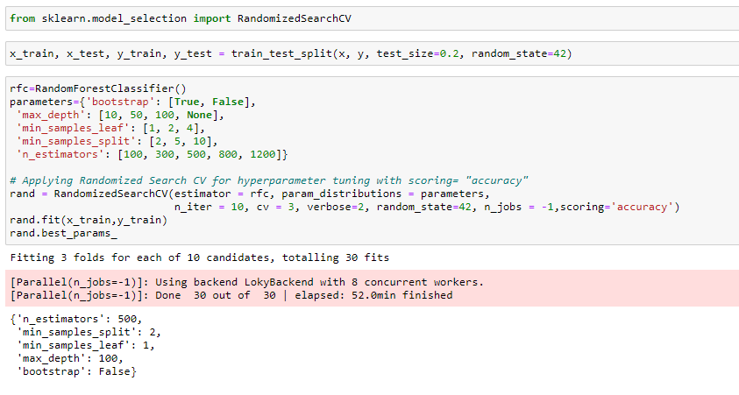
RandomizedSearch CV
Randomized search is an approach to hyper parameter tuning where random combinations are used to find the best solutions for the built models.

Slide 30
BEST MODEL

Slide 31
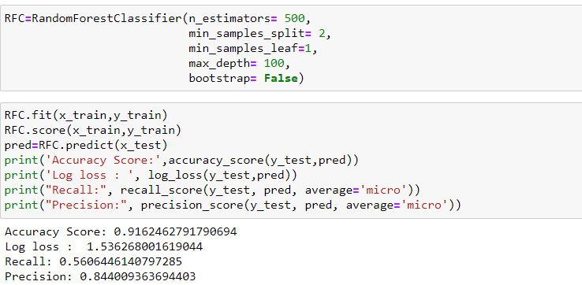
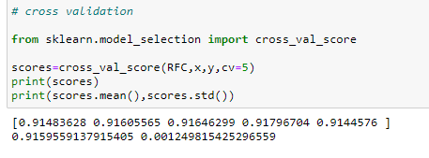
Choosing Best Model
The Random Forest Classifier model is working best and can be considered as finalised model.
Cross Validation

Slide 32
PREDICTION

Slide 33
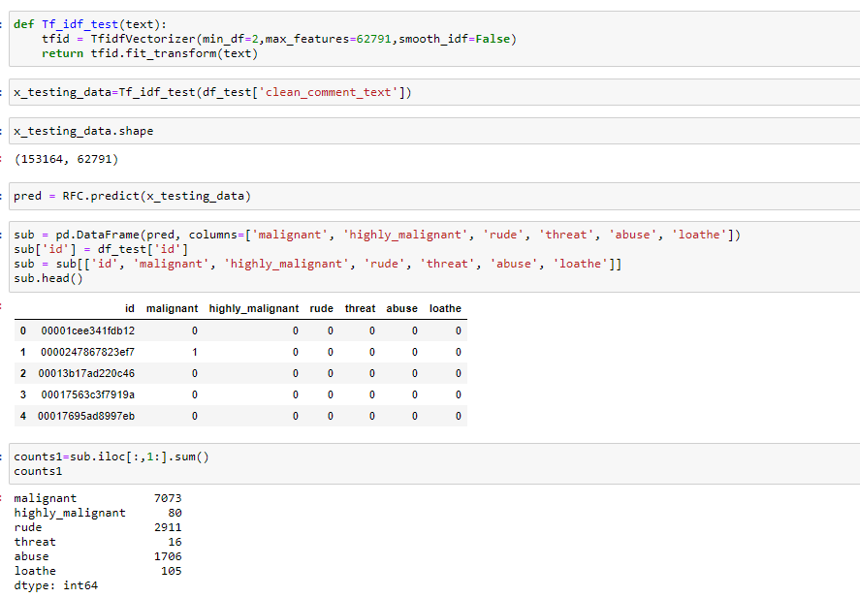
Predict the test data using Random Forest Classifier

Slide 34
CONCLUSION

Slide 35
Key Findings and Conclusions of the Study
This project proposed a Machine Learning Approach combined with Natural Language Processing for toxicity detection and its type identification in user comments. Finally, the best score of minimum log loss was achieved through Random Forest Classifier.
Learning Outcomes of the Study in respect of Data Science
Through this project we were able to learn various Natural language processing techniques like lemmatization, stemming, removal of stopwords. We were also able to learn to convert strings into vectors through hash vectorizer. In this project we applied different evaluation metrics like log loss, hamming loss besides accuracy.
Limitations of this work and scope for future
Some of the limitations can be:
The model might not be able to understand sarcasm.
Sometimes non negative comments can be wrongly classified as negative ones, leading to loss of constructive feedback or comments.

Slide 36
THANK YOU

